Slide 1


Modern Control Theory
Lecture No. 2
Formulaing the State Space Concept
The Big Picture w.r.t. State Feedback, State Estimation, Monitoring
Selection of State Variables & Examples
Transfer Function to State Space & State Space to Transfer Function

Slide 2
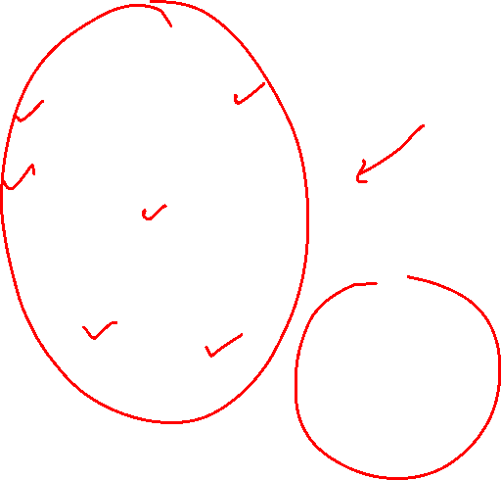
Visualizing the State Space Framework
Any Dynamic System comprises of internal variables, termed as States
No. of States,
Same as Order
of the System
--- effectively the
Number of Energy
Storing Elements
in the System
Knowledge of the
Position & Dynamics
of the States, may
Completely define the
System Dynamics
The Abstract Boundary of the Dynamic System
States
x
x
x
x
x
Similar to Molecules in Newtonian Mechanics
x

Slide 3
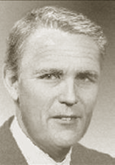
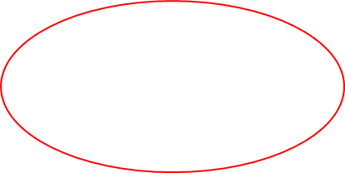
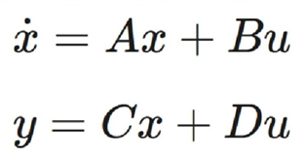
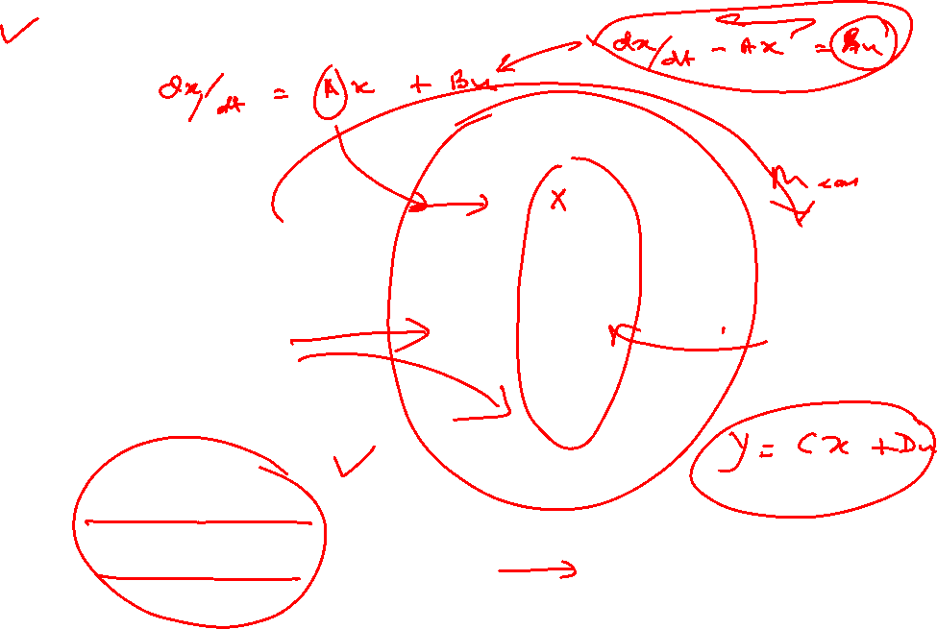
The Concept of State Transfer
Input Space
U
Observation
Space
Y
State Space
X(1)
State Transfer
X(0)
Time Driven

Slide 4
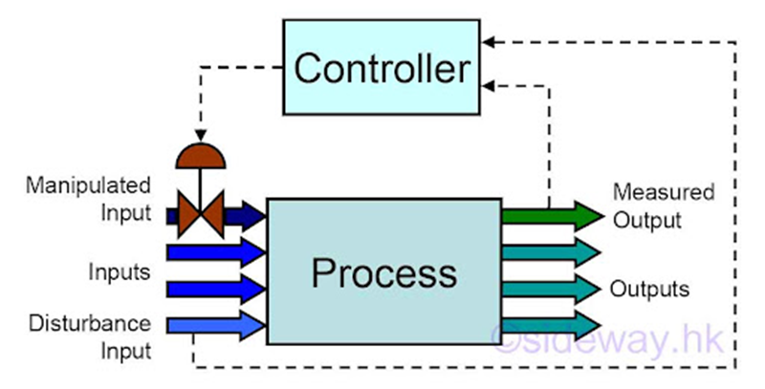
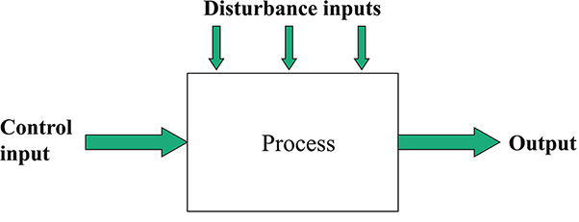
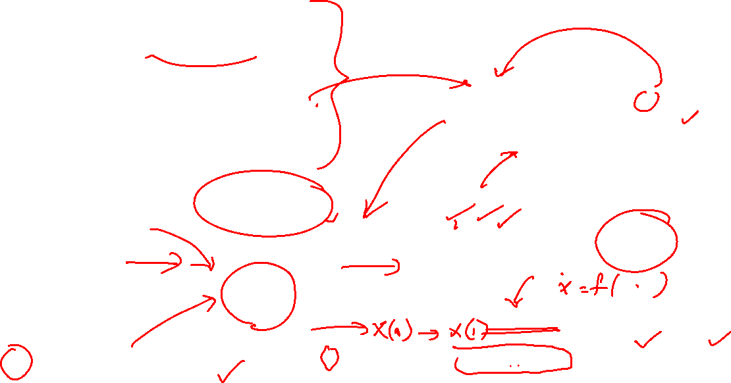
Goal of Feedback Control
Maintain a Set of Variables at some Desirable Values
Of the many variables that impact the process, which are the ones which are the ones that should be controlled ?
What values should these be controlled at ?
How would one control these variables at their specified values ?
P -- System Parameters
X = F(X(0), d, p) for all times. Y = G(X)
X = F(X0, p, d) can be written as
f(x˙, x, p, d) = 0 with x = x(0) at t = 0,
without loss of generality.
X -- Variables that hold all the information about the System
If you know X, then you know the process

Slide 5
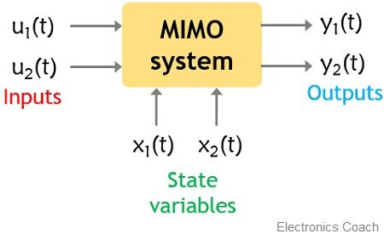
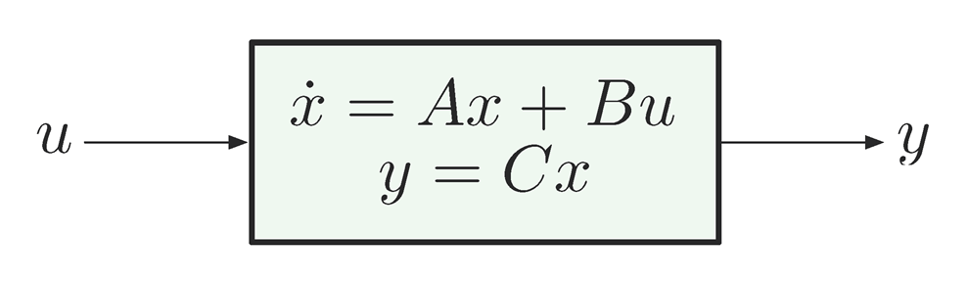
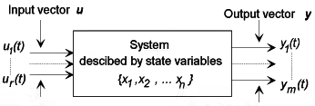
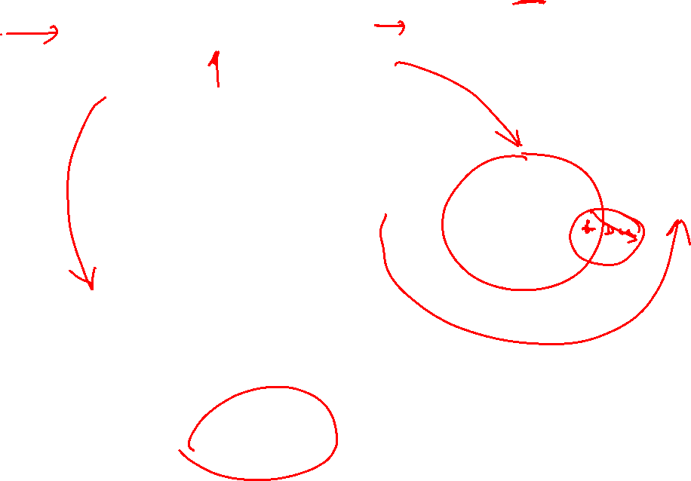
Casting MIMO Systems in the
State Space Framework

Slide 6
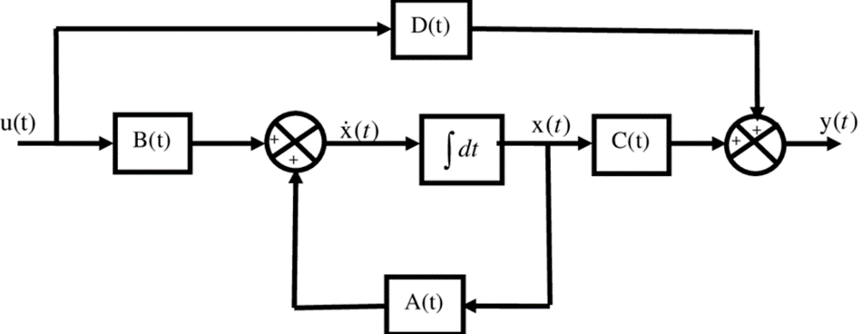
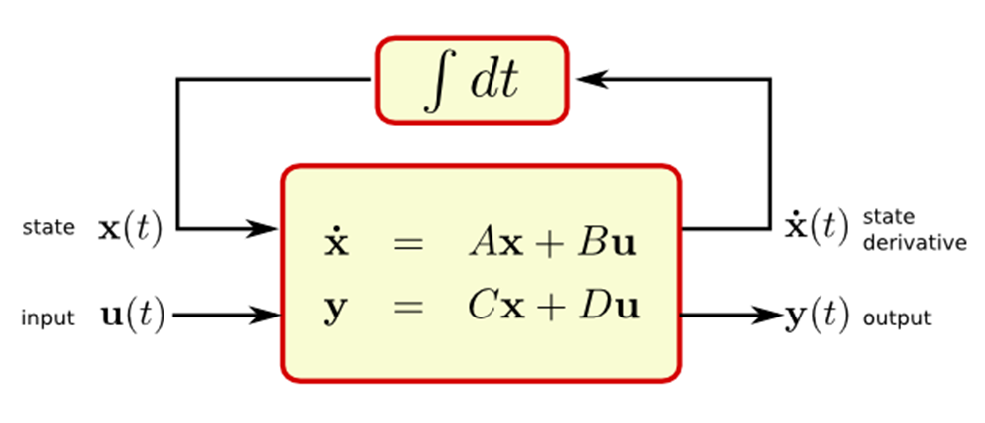
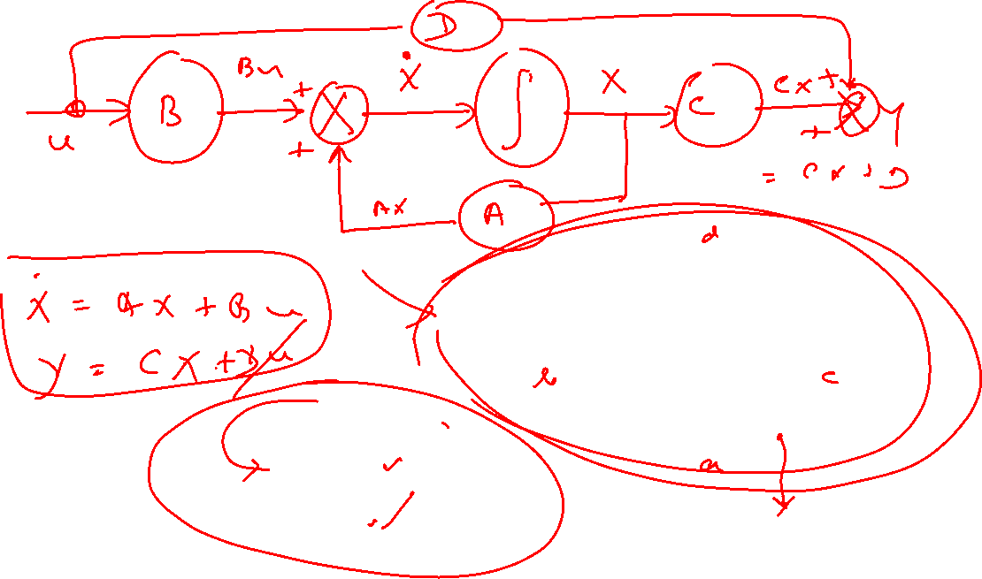
An Insight to the State Space Framework

Slide 7
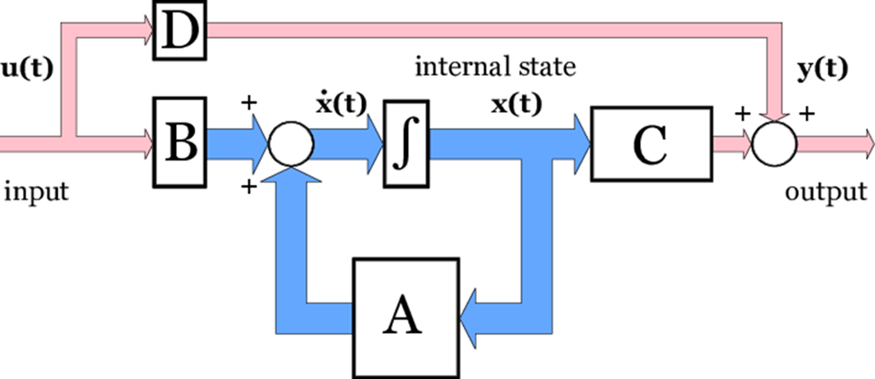
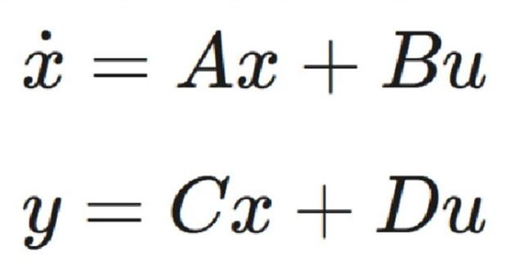
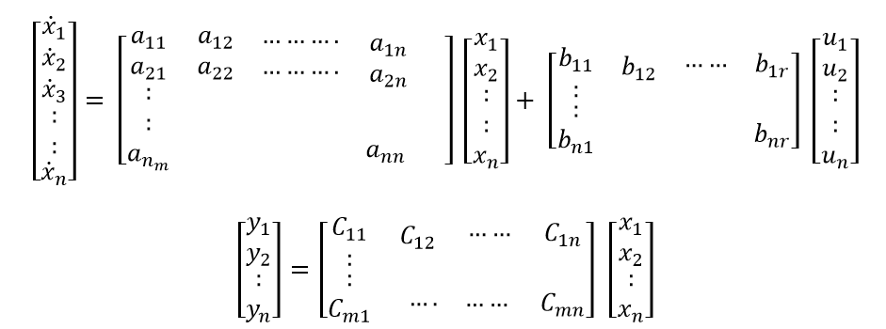
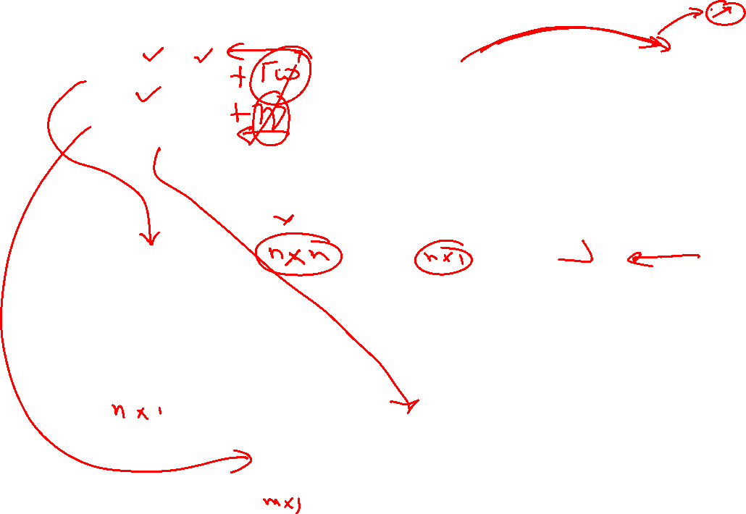
Understanding the State Vector Framework

Slide 8
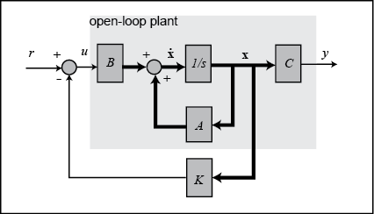
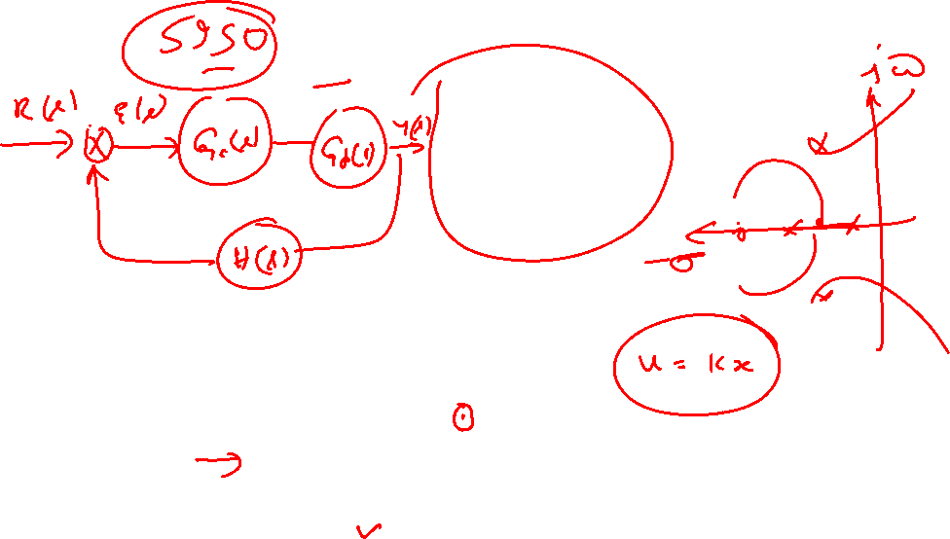
The Big Picture ---- The Concept of State Feedback

Slide 9
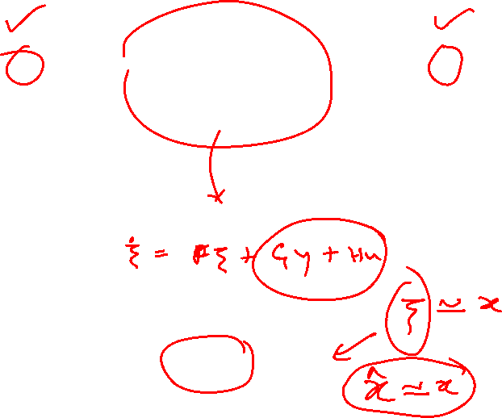
The Big Picture ---- Estimating the State --- Using an Observer
Input, u(k) Output, y(k)
Plant
Model
Estimated State

Slide 10
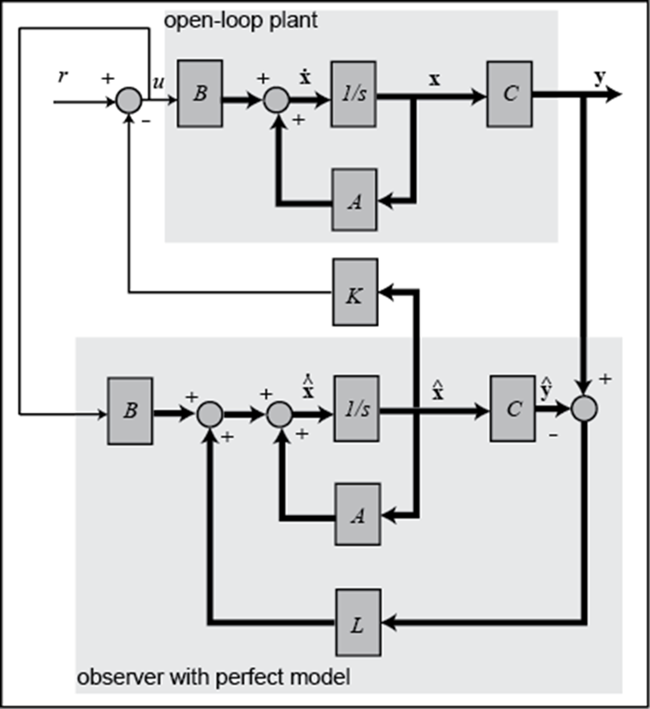
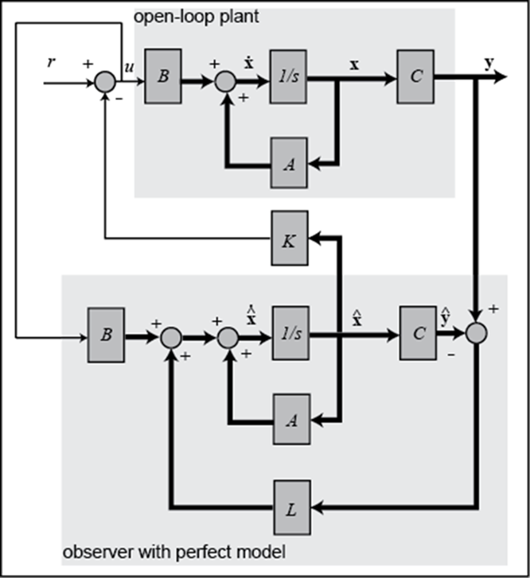
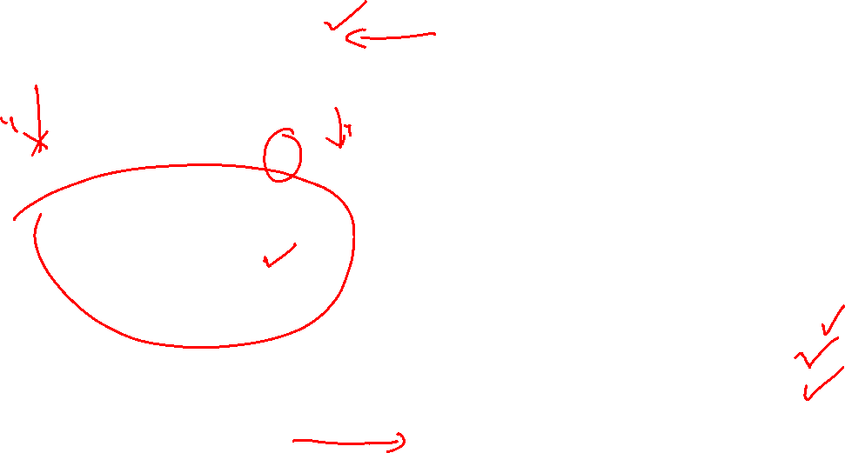
The Big Picture ---- Estimating the State Variable
State Feedback
Pole Placement
Not Connected
Estimated State
Virtual Sensor
Monitoring
Diagnostics

Slide 11
Question Time

